Slide 1
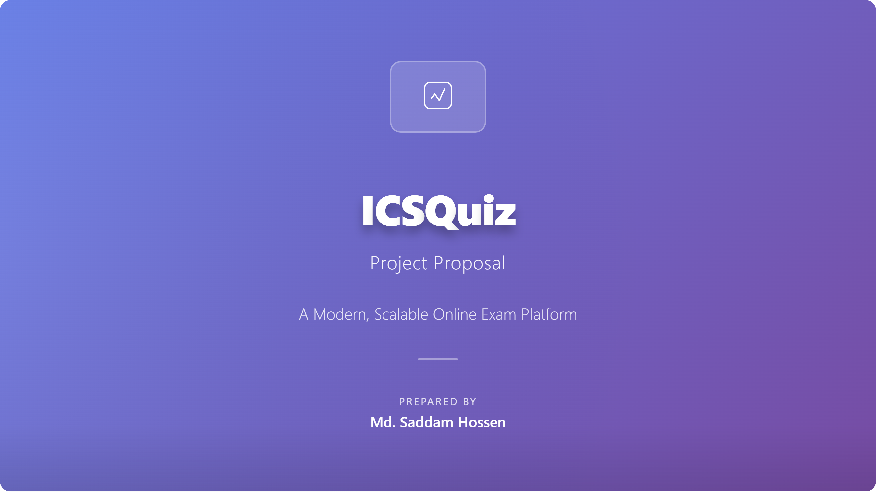
ICSQuiz Project Proposal
A Modern, Scalable Online Exam Platform
Prepared by: Md. Saddam Hossen

Slide 2
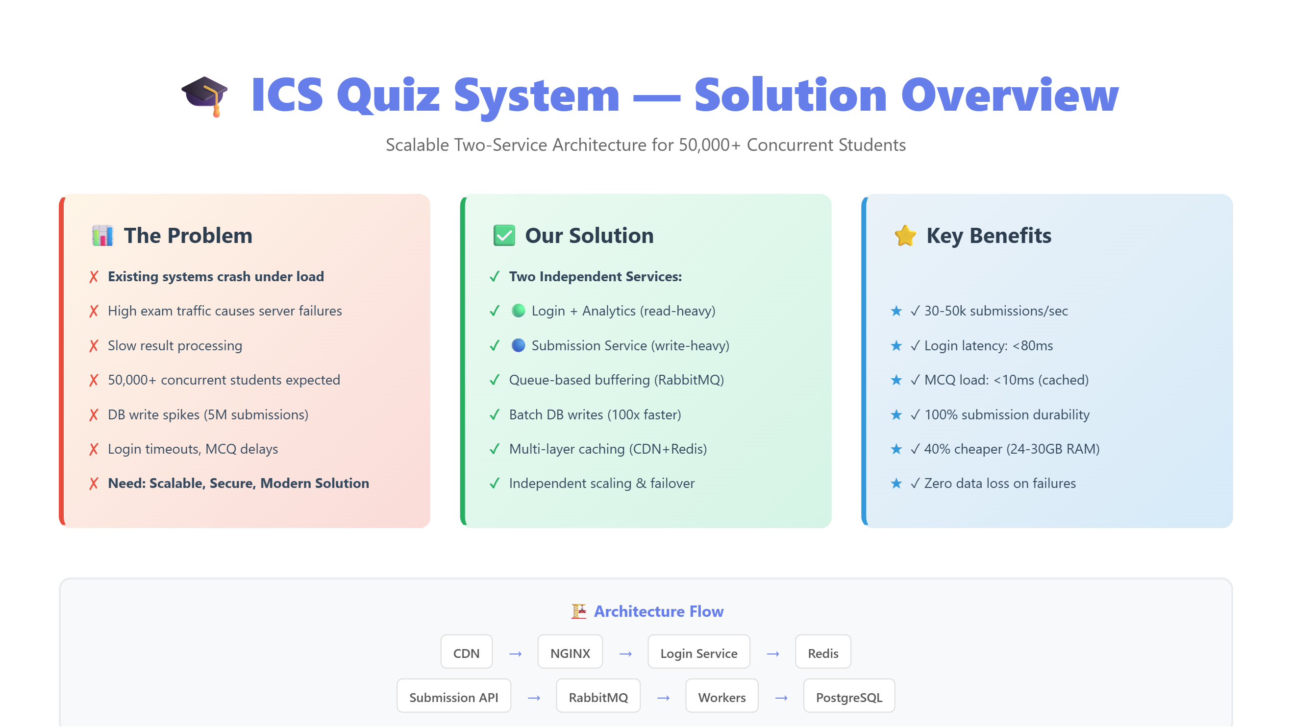

Slide 3
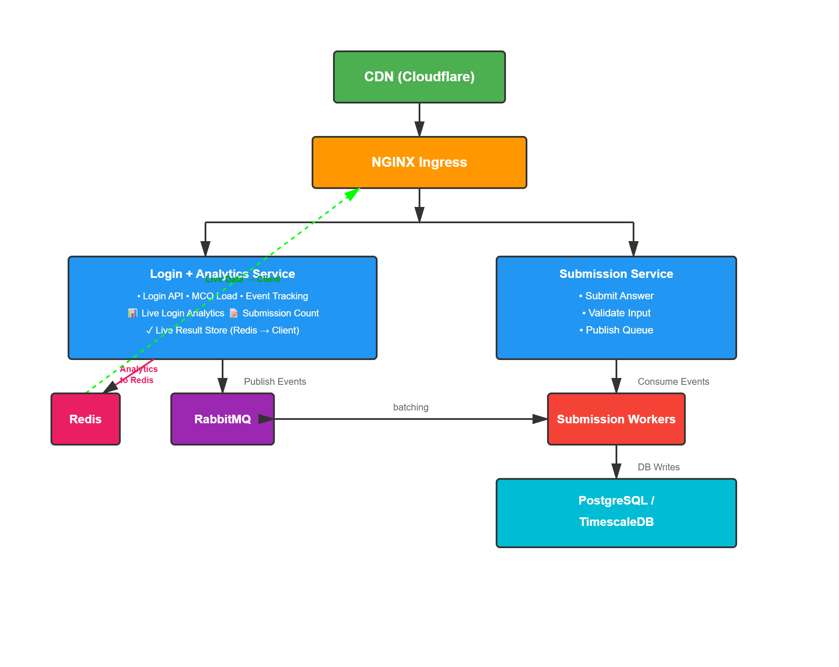
High-Level Architecture

Slide 4
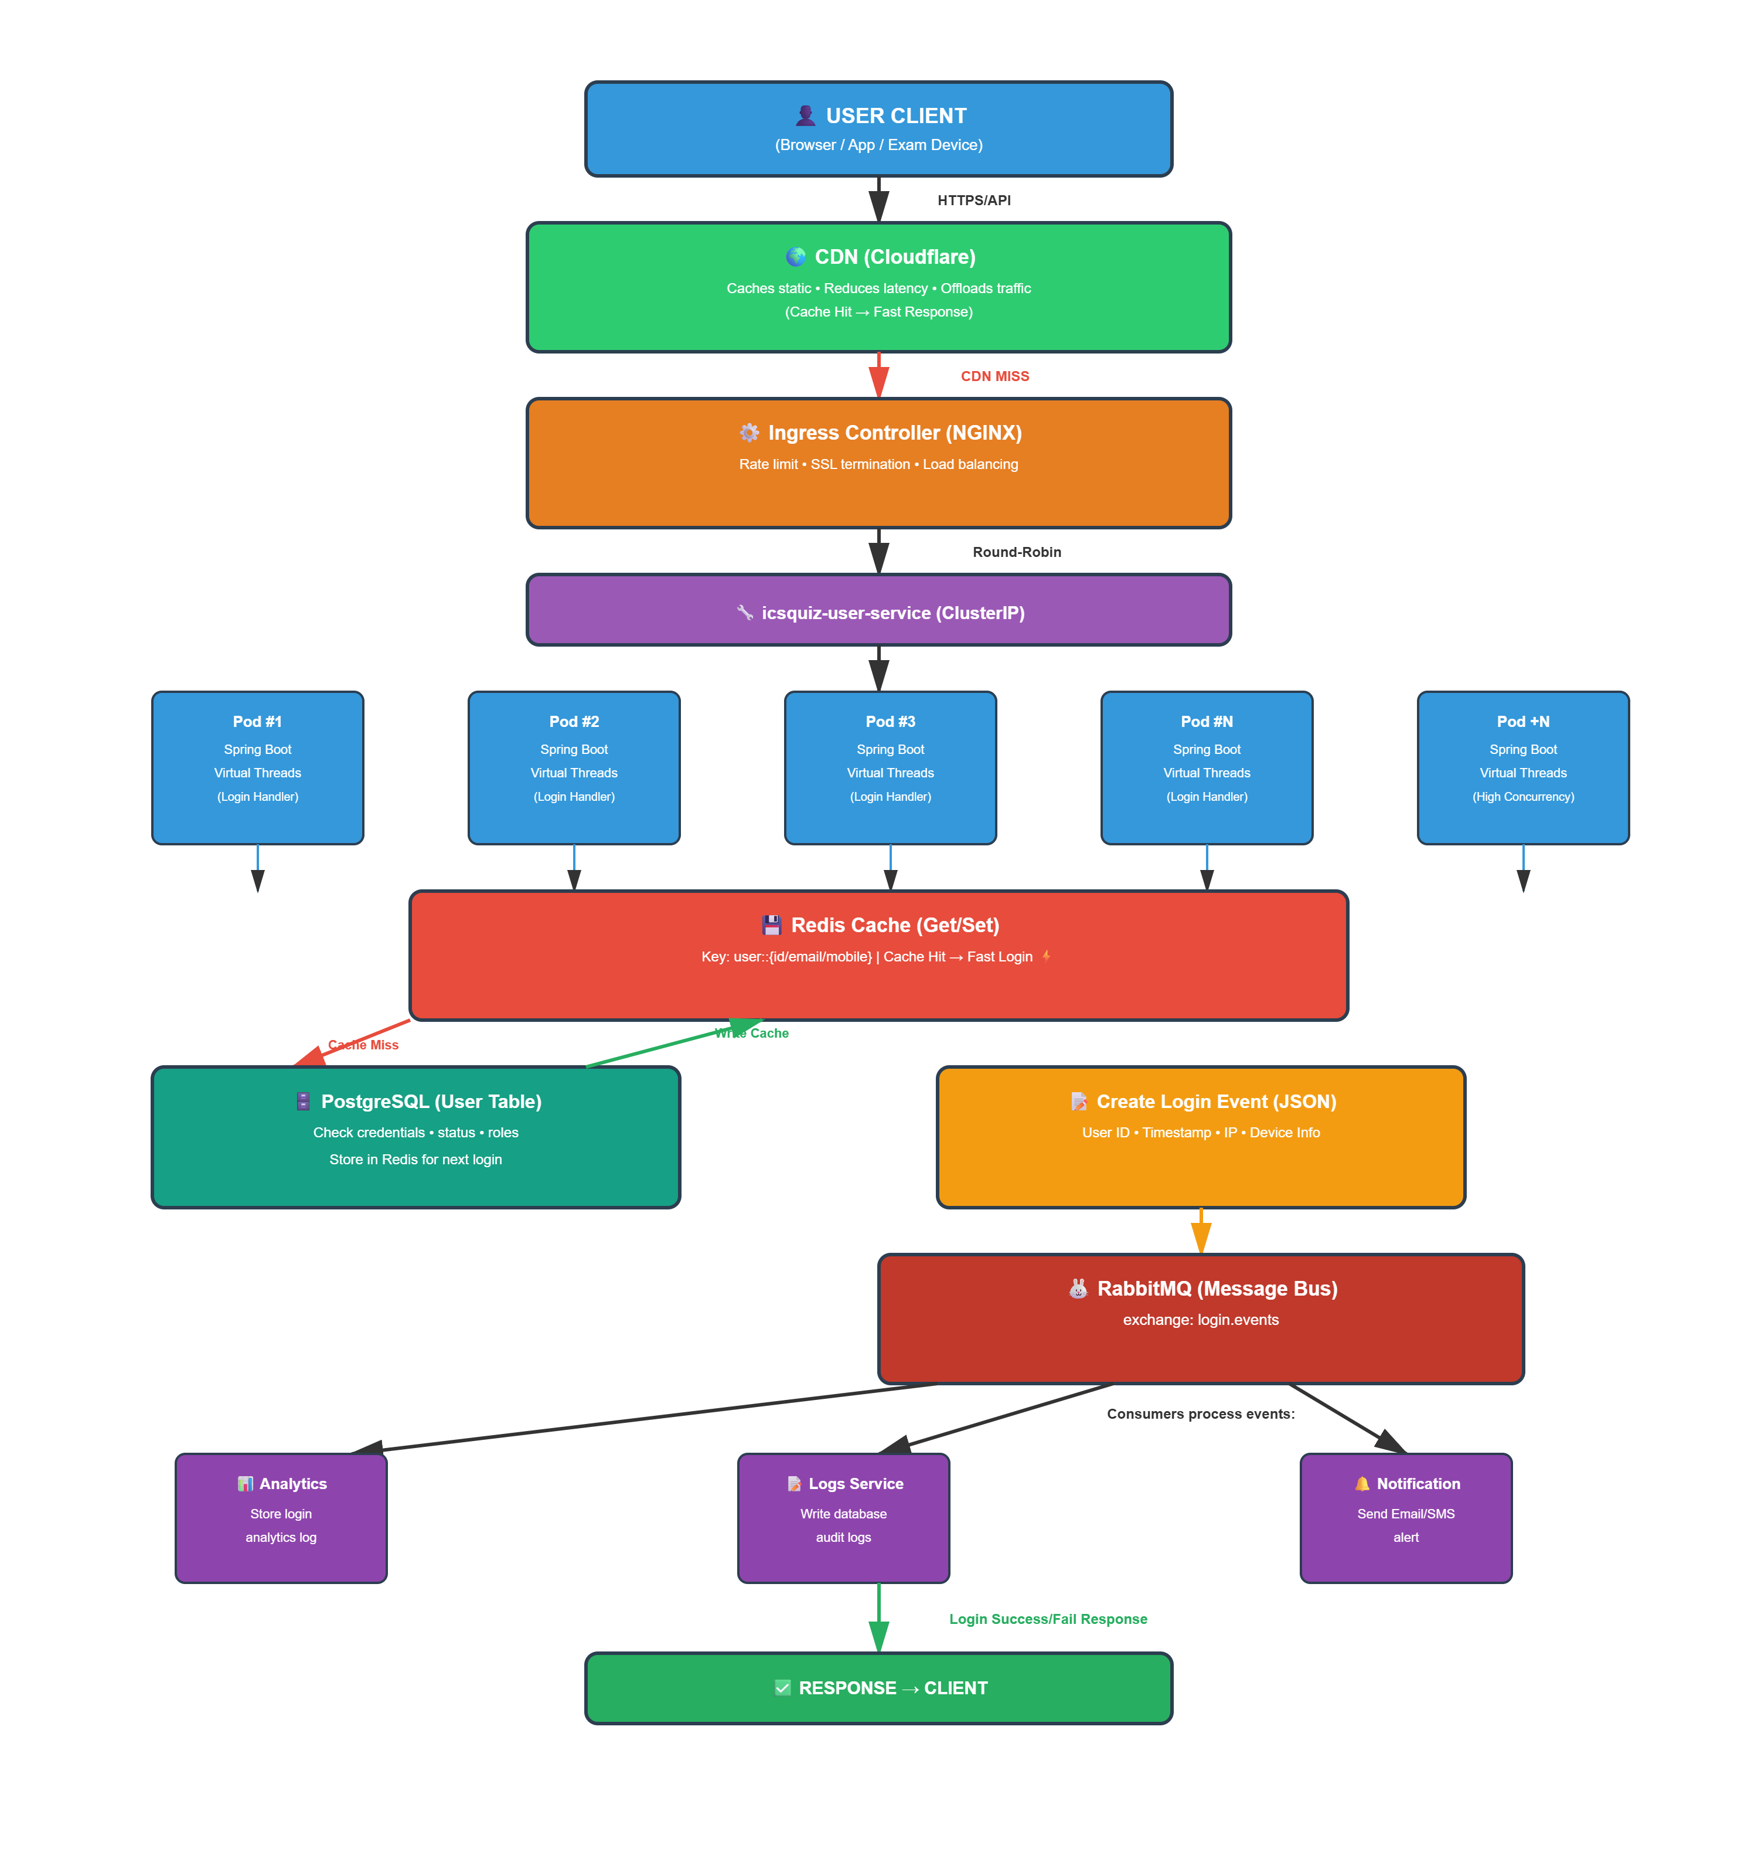
Login + Analytic Service

Slide 5
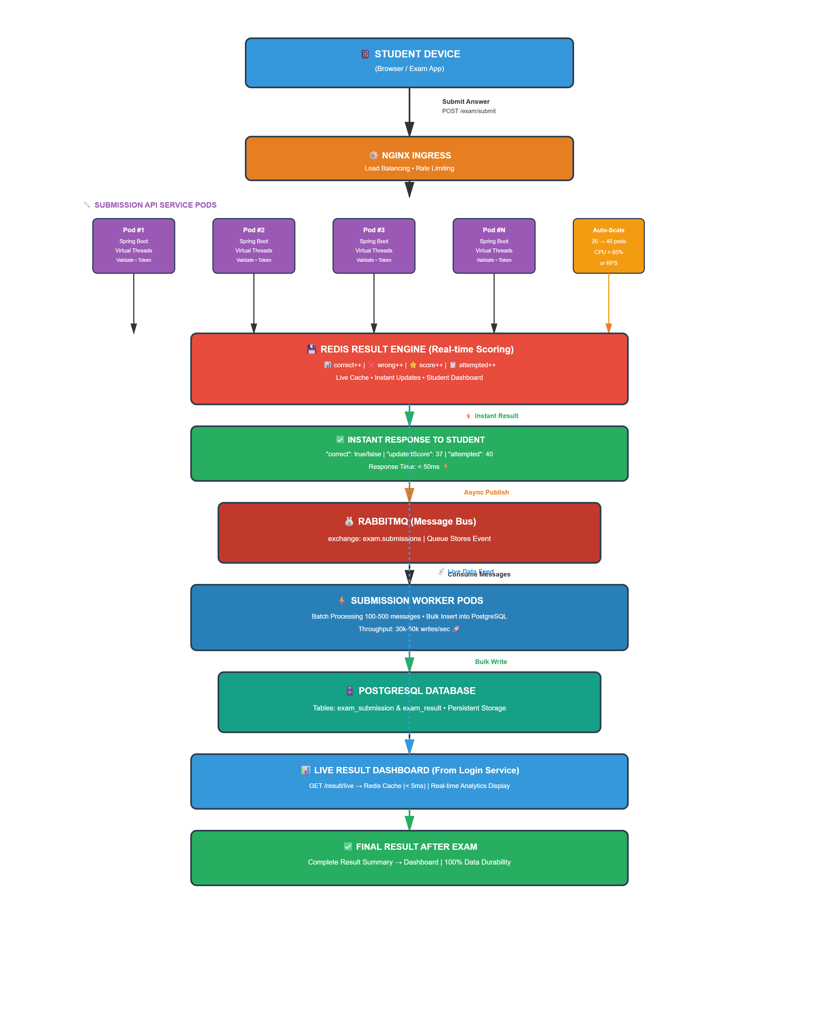
Submission Service

Slide 6
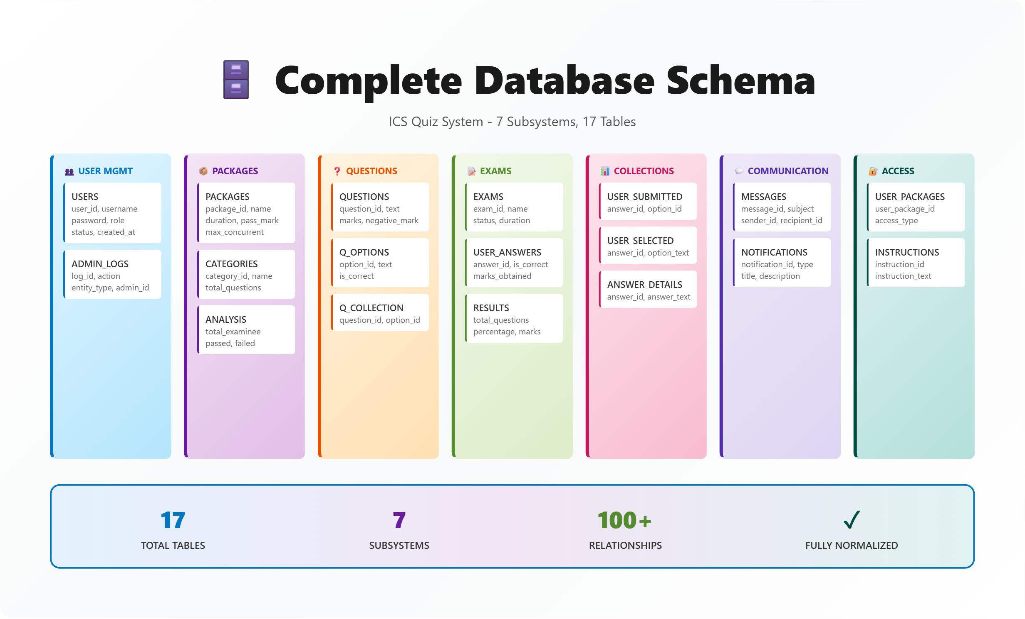

Slide 7
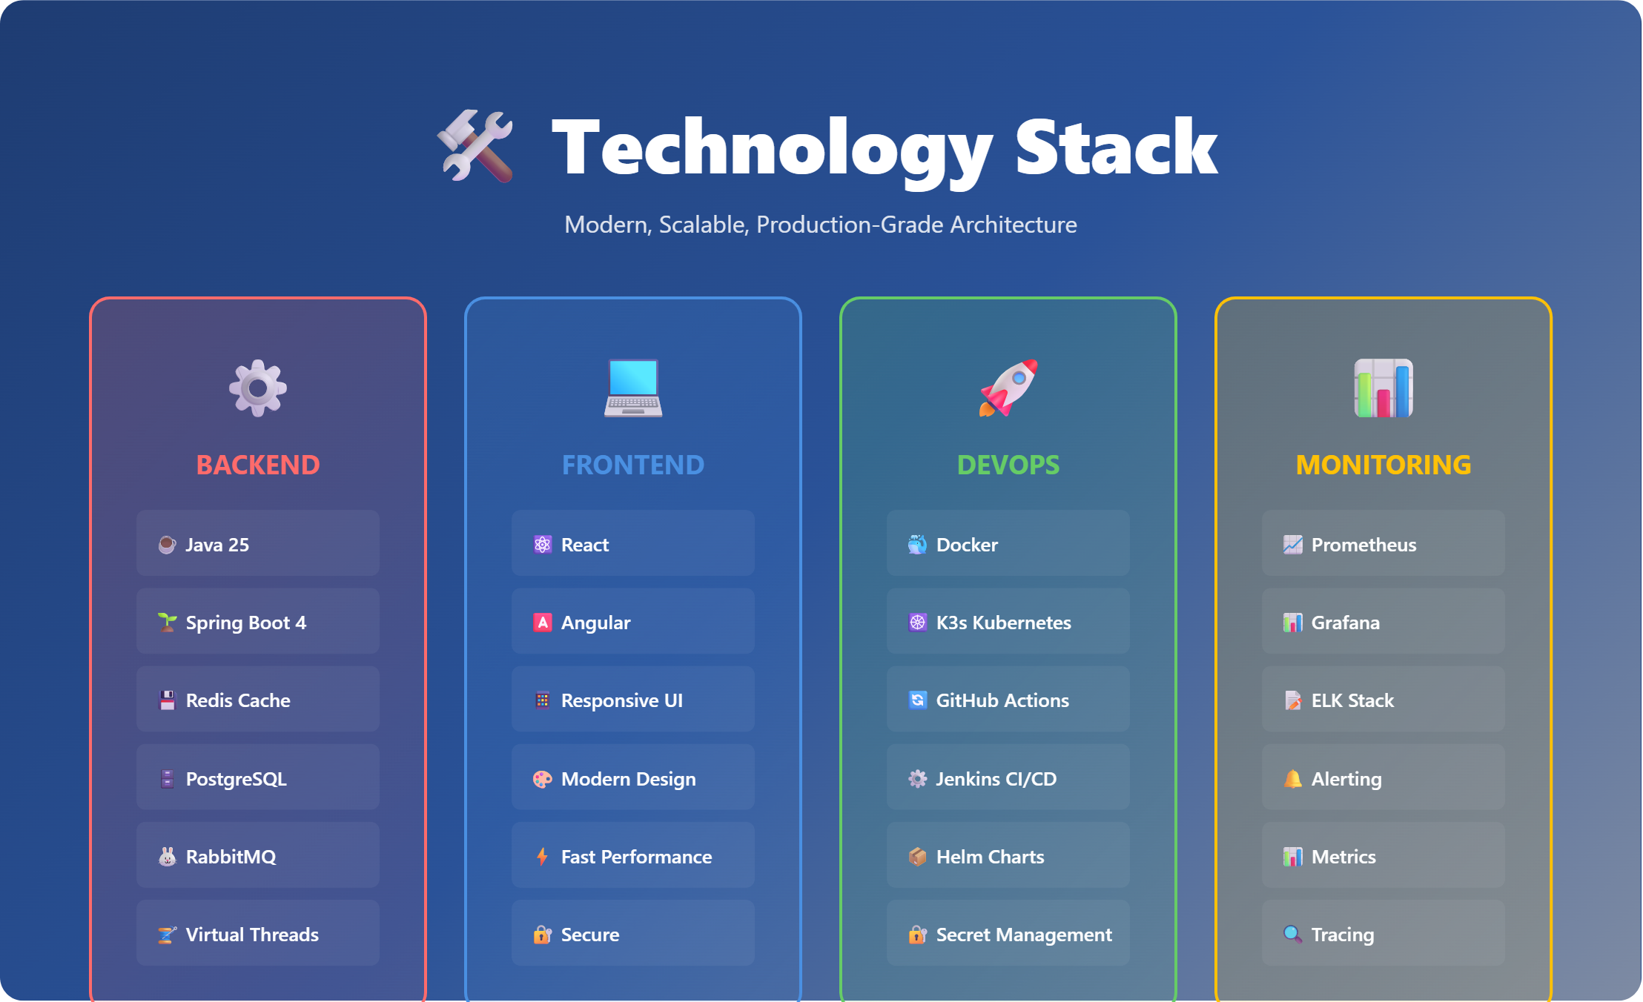

Slide 8


Slide 9
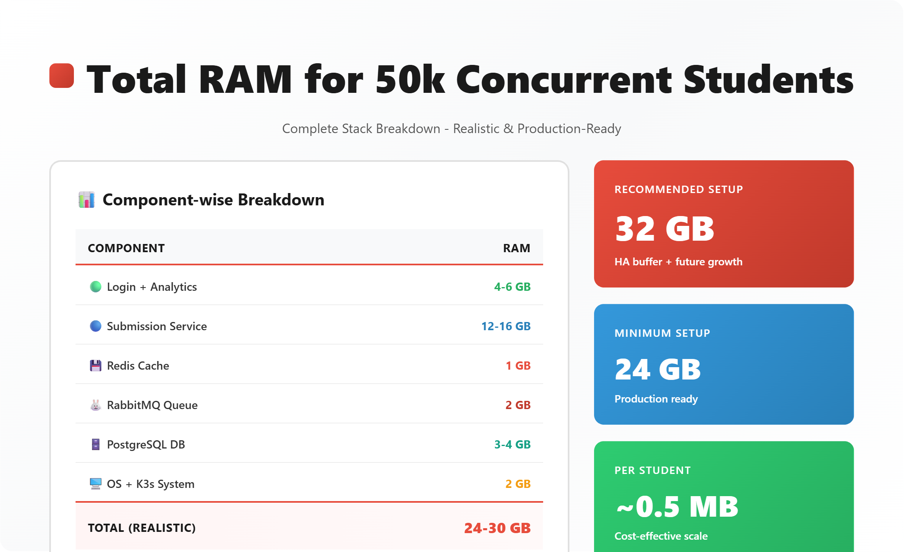

Slide 10
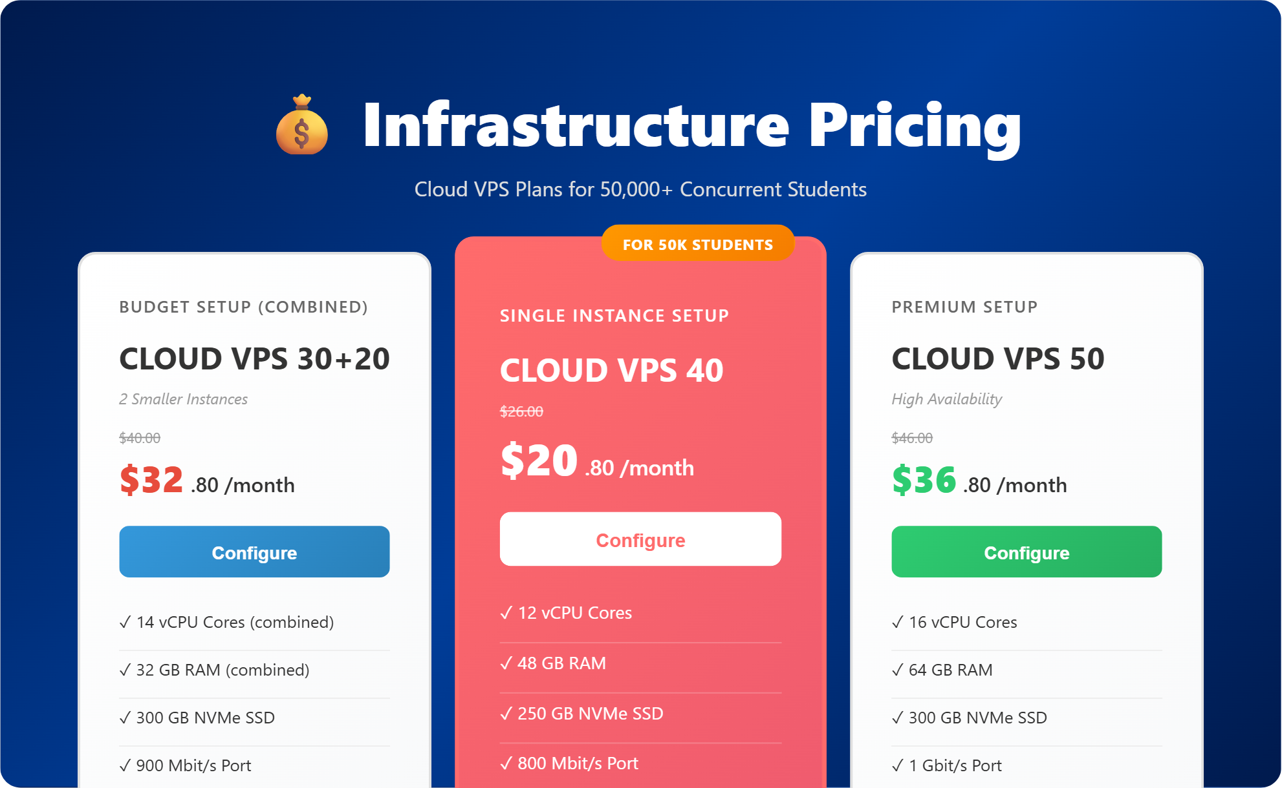

Slide 11
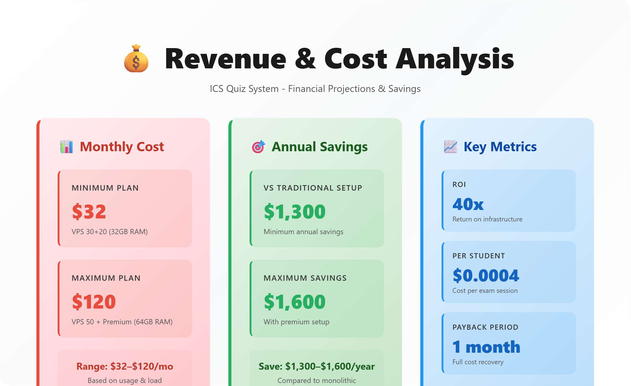

Slide 12

Thank You!
Questions & Discussion

